Slide 1

The use of three-dimensional ultrasound imaging in breast biopsy and prostate therapy. Fenster, et al.
M. en C. Fabián Torres Robles

Slide 2
Abstract
Minimally invasive techniques are rapidly replacing traditional practices because they result in improved benefits for patients, health care providers, payers, employers and hospitals. While two-dimensional (2D) imaging has been used to guide interventional procedures for many decades, the use of three-dimensional (3D) imaging of the anatomy has the potential to provide more accurate and less variable interventional guidance and monitoring options. The development of 3D ultrasound imaging techniques has allowed the development of image-guided therapy and surgery and has the potential to provide inexpensive and near real-time views of the anatomy and pathology enabling minimally invasive interventional procedures.

Slide 3
Introduction
With the increase of computational power and the development of advance 3D visualization technics, the use of image-guided interventions has increase. Because of that the need of increase in accuracy and minimal invasion is bigger than ever.
The use of ultrasound enables the possibility of obtain 3D near real time images to guide a surgical procedure.

Slide 4
2D Ultrasound Advantages
Conventional 2D ultrasound represents thin planes of the patient anatomy, the user has to integrate many 2D images to have a mental 3D map of the anatomy.
The planning and guiding of a procedure requires that the 2D probe is located in an specific position and orientation.
The 2D ultrasound doesn´t allow to acquire planes that are parallel to the surface.
Volumetric measurements has poor accuracy.

Slide 5
3D Ultrasound Technics
Tracked Ultrasound.- 1D arrays that produce 2D images, this images are used to reconstruct a 3D images using the relative position of the 2D images. Low cost, no real time.
Freehand
Mechanical
Tri-dimensional Probe.- 2D arrays that produce 3D images directly. High cost, real time.

Slide 6
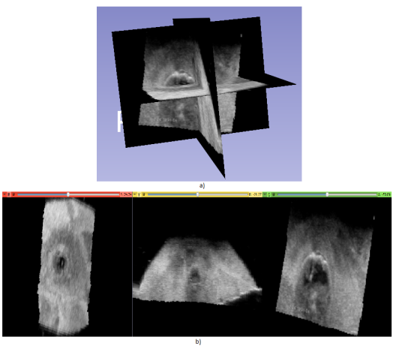
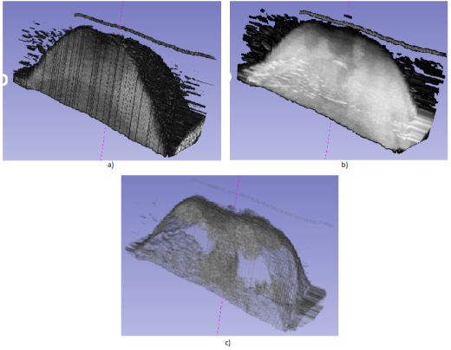
3D Visualization
The visualization technic plays a dominant role in the ability of the user to obtain information from the 3D ultrasound

Slide 7
Prostate Guided Therapy with 3D Ultrsound
In the past decade, investigators have searched for alternative minimally invasive therapies to treat localized prostate cancer. Of these, brachytherapy is the most advanced and is considered to be an important treatment option.
The most common form of prostate brachytherapy involves the implantation of about 80 radioactive seeds into the prostate. By proper placement of the seeds, the prostate can be subjected to a high radiation dose while sparing surrounding tissues.

Slide 8
CT or ultrasound is used to determine the geometry of the prostate and the location of cancer. The user make a plan using this information and knowledge of the radiation distribution around the seeds.
Since implantation errors can occur and the seeds may migrate, the actual seed locations are determined with CT or fluoroscopy at an additional separate outpatient visit after the implantation.
3D ultrasound with rapid scanning and immediate viewing of the 3D prostate anatomy is the best candidate imaging technology allowing a complete intraoperative procedure.

Slide 9
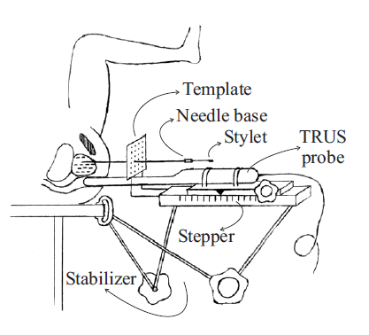
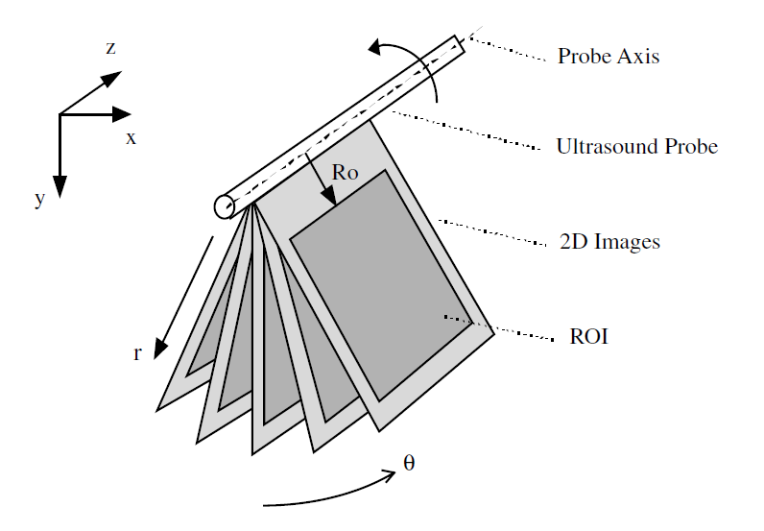
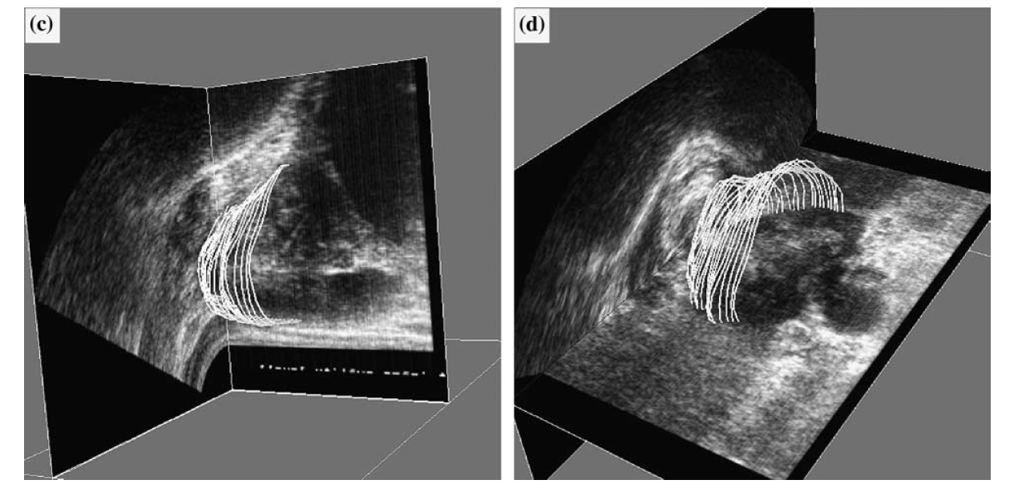

Slide 10
Biopsy Guided with 3D Ultrasound
Stereotactic biopsy uses high resolution pre-operative images to plan the procedure, such as stereo X-ray or CT. After the needle insertion, the user acquire another x-ray image to confirm the correct placement of the needle.
X-ray imaging is an invasive procedure because of the radiation, while CT does not provide real time images.
This method combines the advantages of Stereotactic biopsy and 3D Ultrasound.

Slide 11
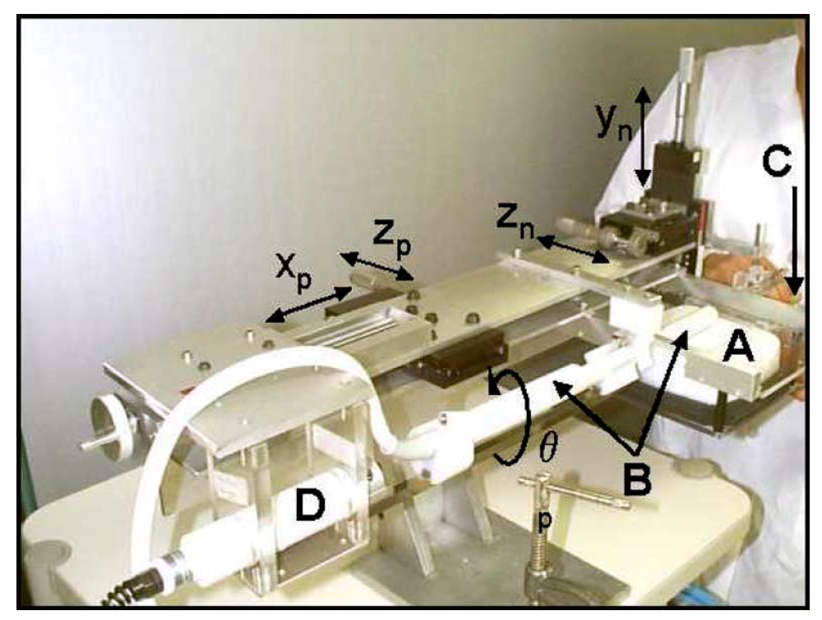

Slide 12
Conclusions
The use of 3D ultrasound may allow the development of intra-operative technics, in which all steps are carried out in one session.
3D real-time ultrasound would increase the procedure efficiency.
Improved visualization technics are needed to make the 3D view more intuitive.

